Slide 1
World happiness report 2018 - 2022
How a Global Pandemic Affected Happiness
By:
Ian Cook
Kayla Lopilato
Breylan Pierce

Slide 2
Purpose:
By using visualizations, we will provide a thorough examination as to how happiness changed 2018 – 2022 during a global pandemic.
Original questions:
What is the level of happiness prior to 2020?
What is the level of happiness in 2020?
What is the level of happiness after 2020?
What is a country’s happiness change over time?
Highest and lowest happiness levels over time by country?
Happiness Score vs Economy
Happiness Score vs Health (life expectancy)
Happiness Score vs Freedom
New questions:
Countries change of happiness 2018 – 2022
The consistency of happiness 2018 -2022
Happiest and unhappiest countries 2018 -2022
Year of maximum happiness
How economy, health, and freedom changed over time
The correlation of happiness, economy, health, and freedom

Slide 3
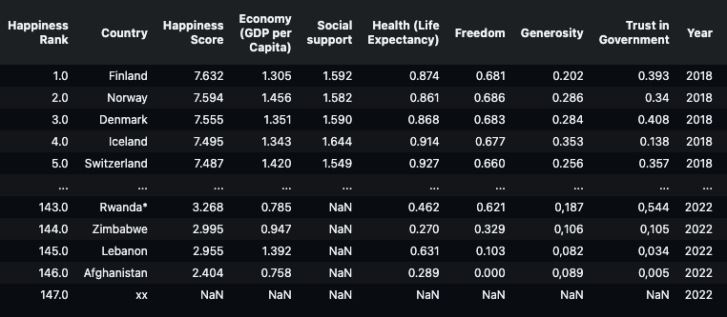
Dataset
World Happiness Report up to 2022 provided by Mathurin Aché on Kaggle
Selected five csv’s 2018– 2022
After adding respective years, the csv’s were merged while renaming and standardizing columns.

Slide 4
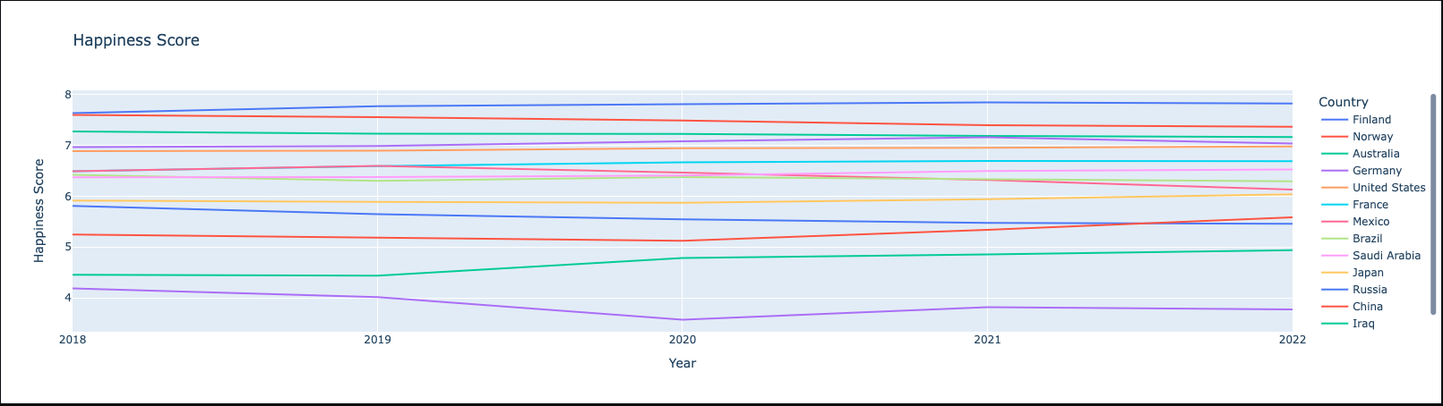
Countries Change of Happiness 2018 - 2022

Slide 5
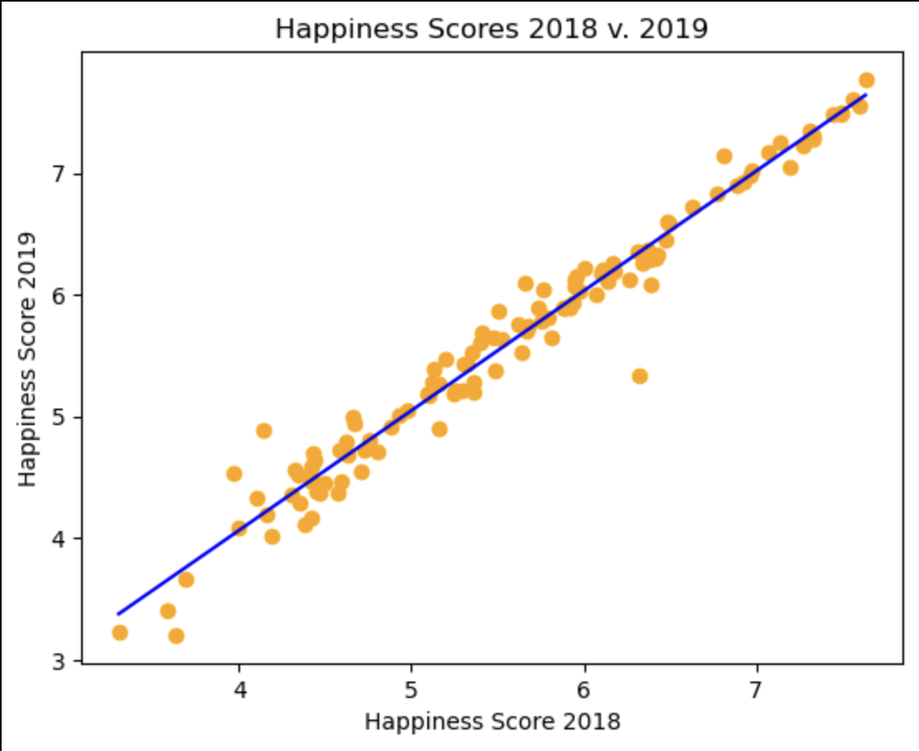
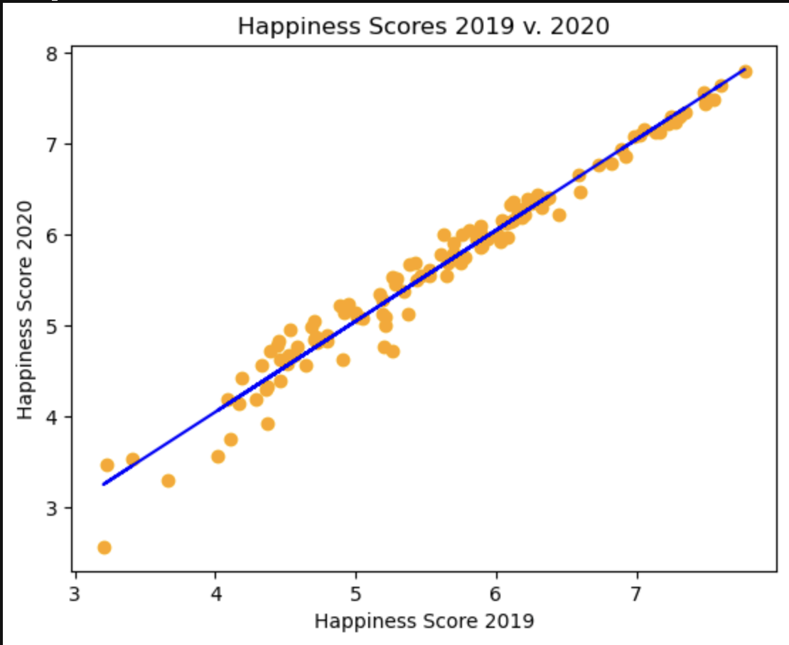
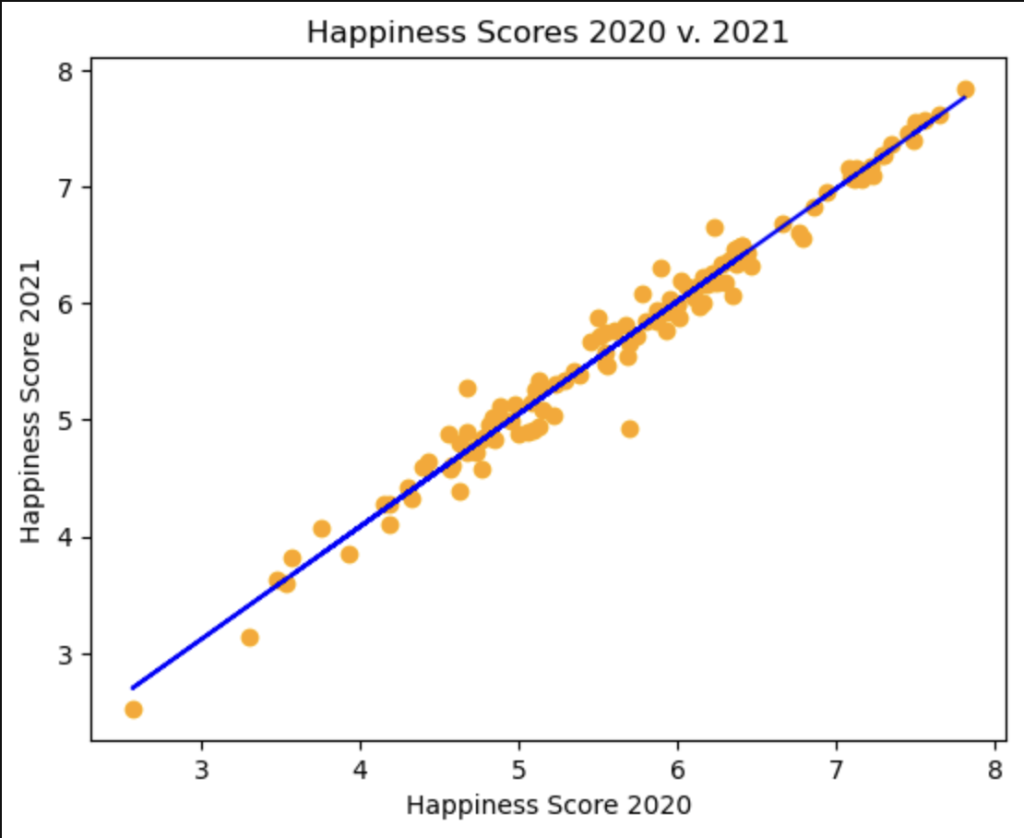
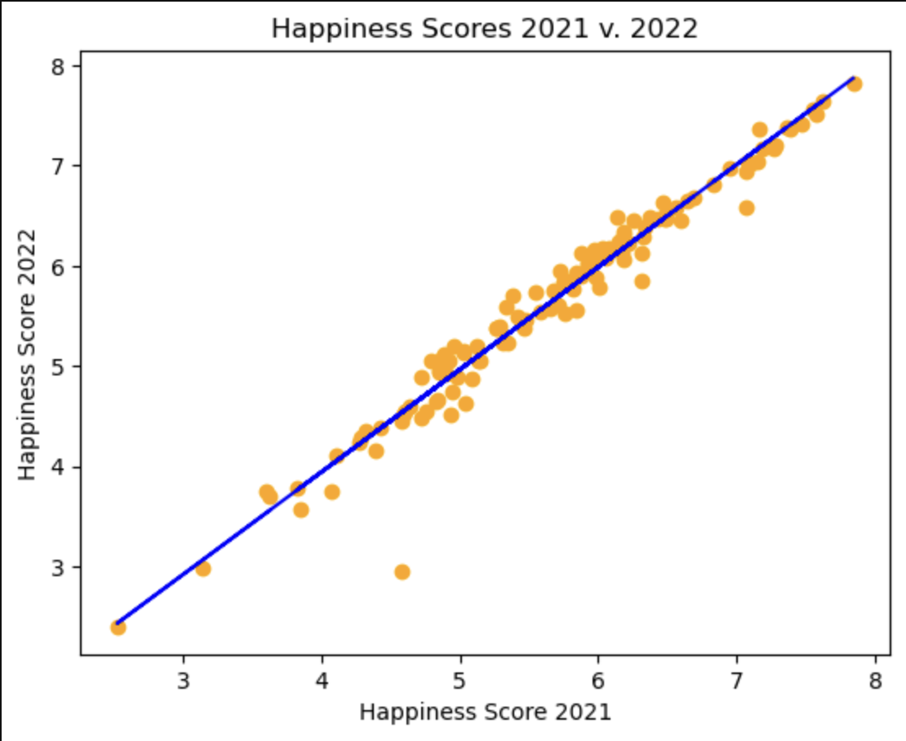
The Consistency of Happiness 2018 - 2022
There is a strong correlation each year of happiness score consistency.
2018 – 2019
R-value
0.966
2019 – 2020
R-value
0.969
2020 – 2021
R-value
0.976
2021 – 2022
R-value
0.960

Slide 6
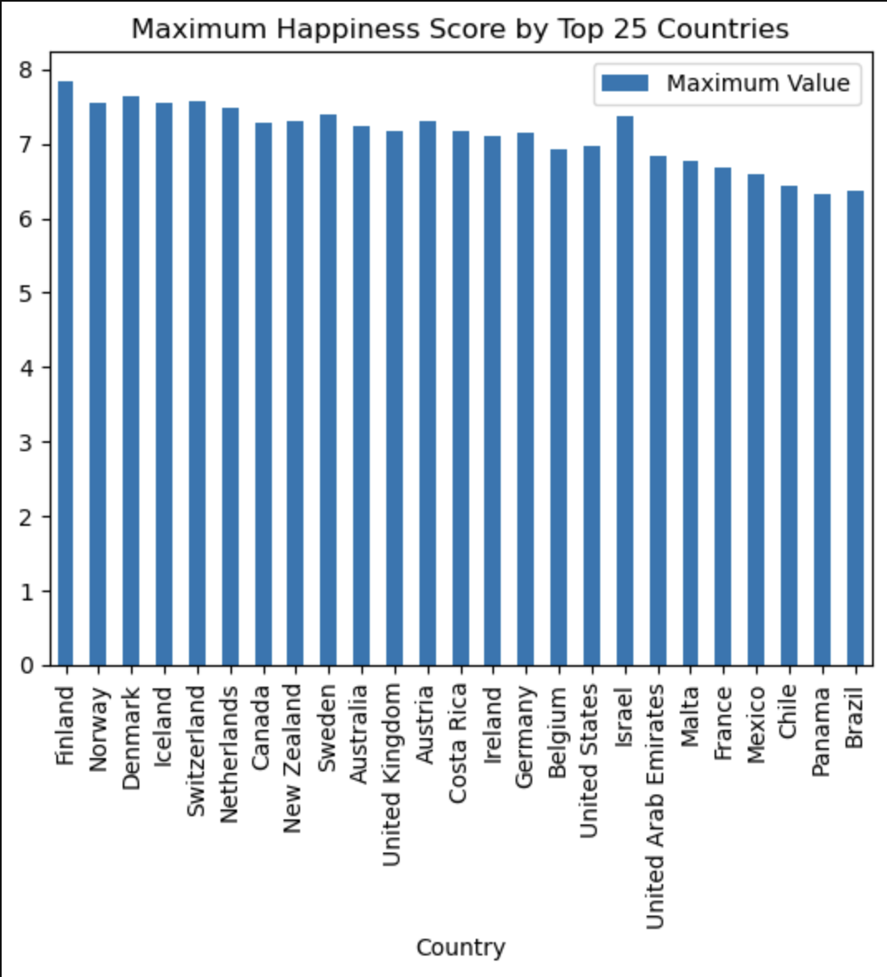
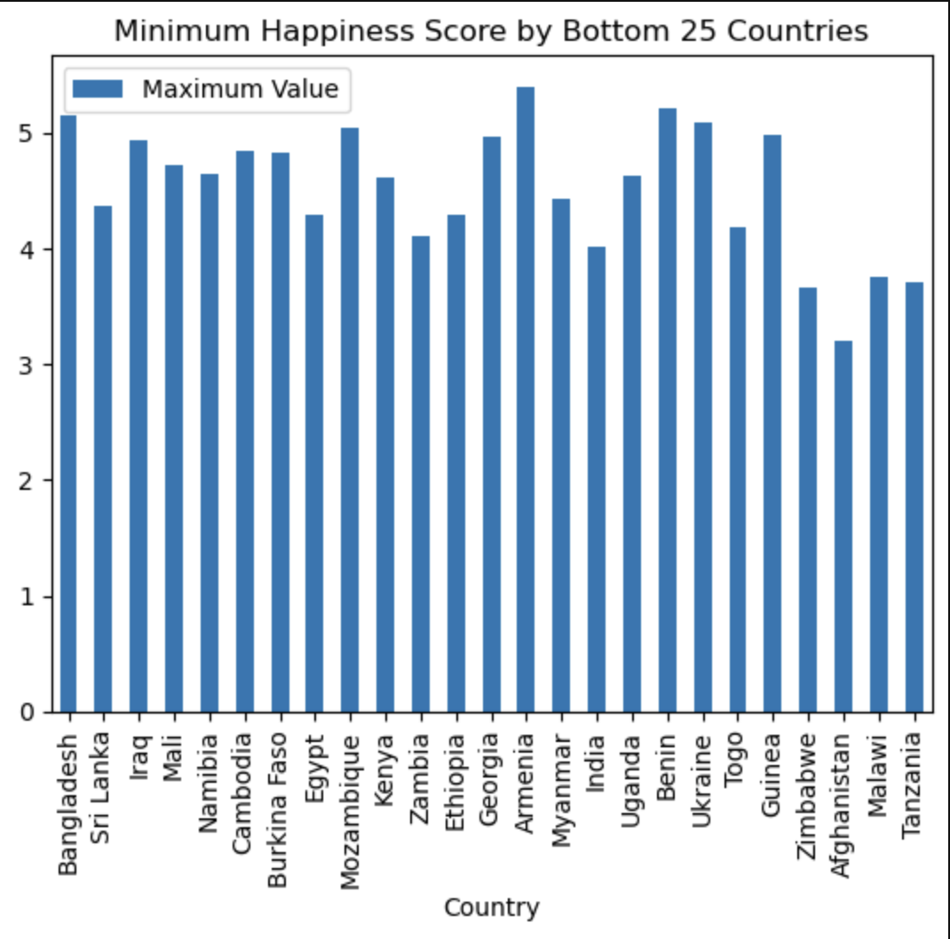
Happiest and Unhappiest Countries 2018 - 2022
Maximum
Happiest Countries & Years:
Finland (2021)
Denmark
(2020)
Switzerland
(2021)
Minimum Happiest Countries & Years:
Afghanistan
(2019)
Zimbabwe
(2019)
Tanzania
(2022)

Slide 7
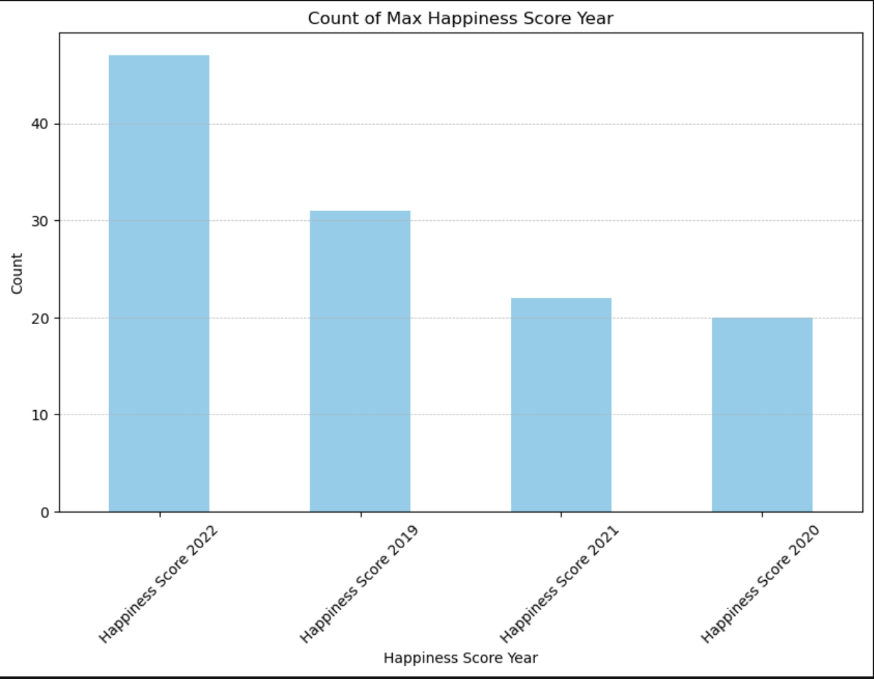
Year of Maximum Happiness
2022 contains the highest number of maximum happiness scores of countries.
2020 contains the lowest number of maximum happiness scores of countries.

Slide 8
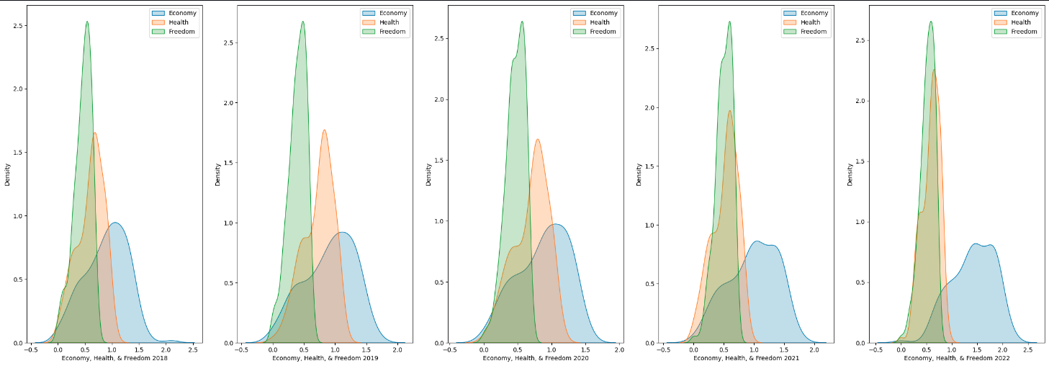
How Economy, Health, and Freedom changed over time:
Freedom remained consistent; health and freedom fluctuated.

Slide 9
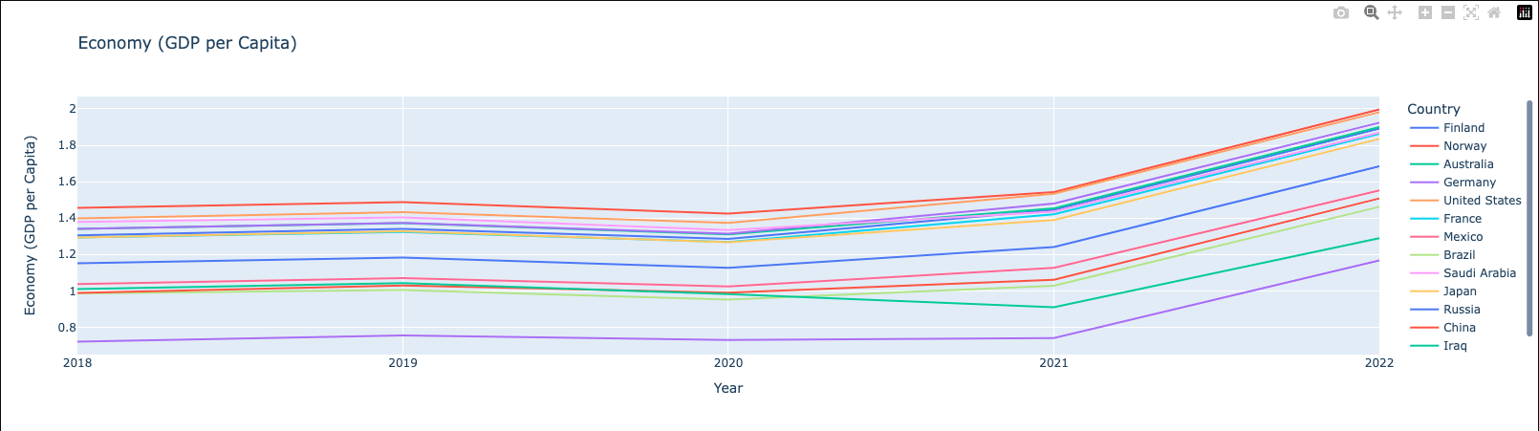
Economy is consistent 2018 – 2019 then dipped in 2020.
In 2021, the economy shows a notable upward trajectory carrying into 2022.

Slide 10
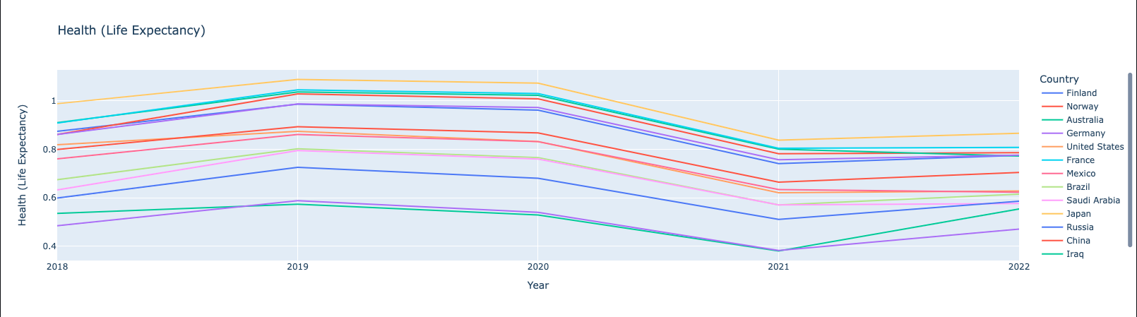
Health shows a slight increase from 2018 – 2019 with a stark decline in 2020 through 2021.
Since 2021, it has not recovered to pre-2020 levels.

Slide 11
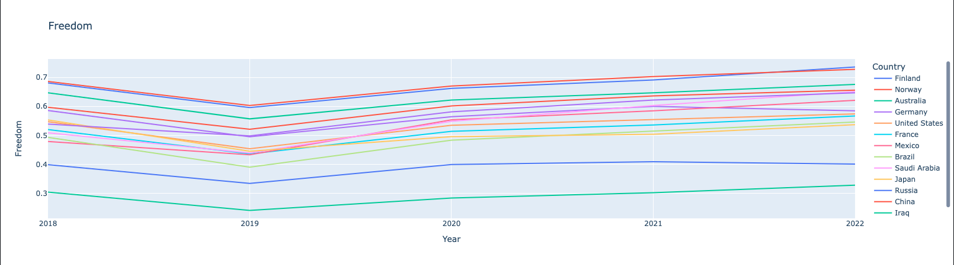
There is decline in freedom from 2018 to 2019.
There has been a steady increase in freedom overall 2019 – 2022.

Slide 12
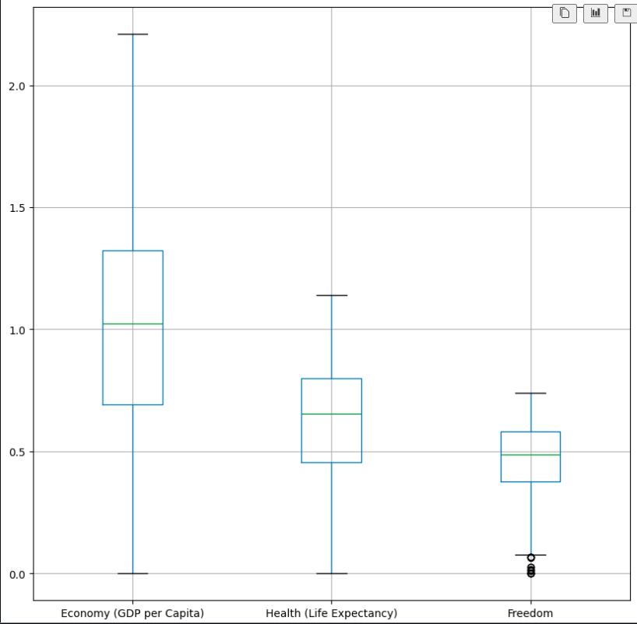
Further Analysis of How Economy, Health, and Freedom changed over time:
Economy has the largest variance.
Freedom has the lowest variance with notable outliers.

Slide 13
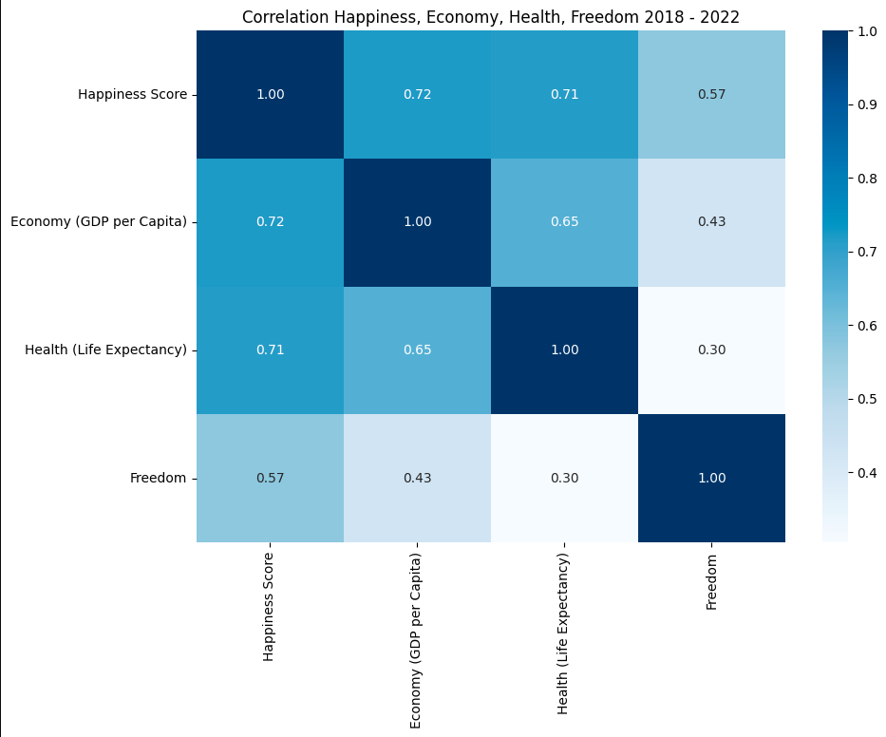
The Correlation of Happiness, Economy, Health, and Freedom:
The strongest correlation is between happiness and economy.
The weakest correlation is between health and freedom.
While economy has the strongest correlation, health has the next highest correlation with happiness.
Freedom doesn’t have a strong correlation with happiness, economy, and health.

Slide 14

Limitations:
Since only 2018 – 2022 was analyzed, it is a small sample which doesn’t cover the full scope of a global pandemic.
Only a few selected categories were analyzed due to inconsistency in collected data.
Difficulty in quantifying happiness with limited datasets.

Slide 15
Summary:
Overall happiness scores remained consistent for each country over the five years.
2022 appears to have the highest happiness score; 2020 appears to have the lowest happiness score.
Freedom doesn’t show a strong correlation with the other data points even though is has the least fluctuation.
Health and economy fluctuated over time but have the strongest correlation to happiness from the data selected.

